Slide 1
Capstone – Smart Pollution Mask POC
Charles Christianson
SEIS744 Internet of Things

Slide 2
Concept (Usefulness/Validity)
I wanted to build on the idea of the Smart Pollution Mask. Originally an idea for an unbounded exercise, the challenge is to determine if it could work as a real product.
Proof-of-concept type project – can I build a sensor/processor/communication apparatus that could be fitted to a mask.
Due to time, skill, and budget limitations, my focus for this class will be on the electronic circuit and data path from device to cloud.
Still need to consider size, weight, power, cost for it to be viable.
Background
Air pollution is a serious concern in many parts of the world
Extreme pollution can be dangerous, but even less obvious pollution can have serious health consequences
A variety of masks exist, but they do not tell you when you should be wearing them.
Alternatives
Wearable sensors (Lot of activity here)
What about Commercial/Industrial/HazMat applications? Higher budget (but higher cost/criticality)
Market
large urban centers with high pollution levels. Demand for pollution masks in the US is a bit unclear right now, but it seems likely to grow (unfortunately.) Some Asian or other highly industrialized areas have great immediate potential.

Slide 3
System Design and Function
Hardware included in this version:
Particle Photon (main controller, wi-fi for internet connectivity and geolocation
SPEC Digital Sensor board (with NO2 Sensor – could also by O3, etc.)
Button to select mode (sensor read or not) – this simulates the device being “in standby” mode.
Button to select “offline mode” – this simulates loss of internet connectivity
Using internal Photon LEDs for indicators. (not using photon buttons because they are so small, plus complexity)
Hardware not included
Battery
Physical Mask mockup
More elaborate LEDs
Bluetooth, cellular

Slide 4
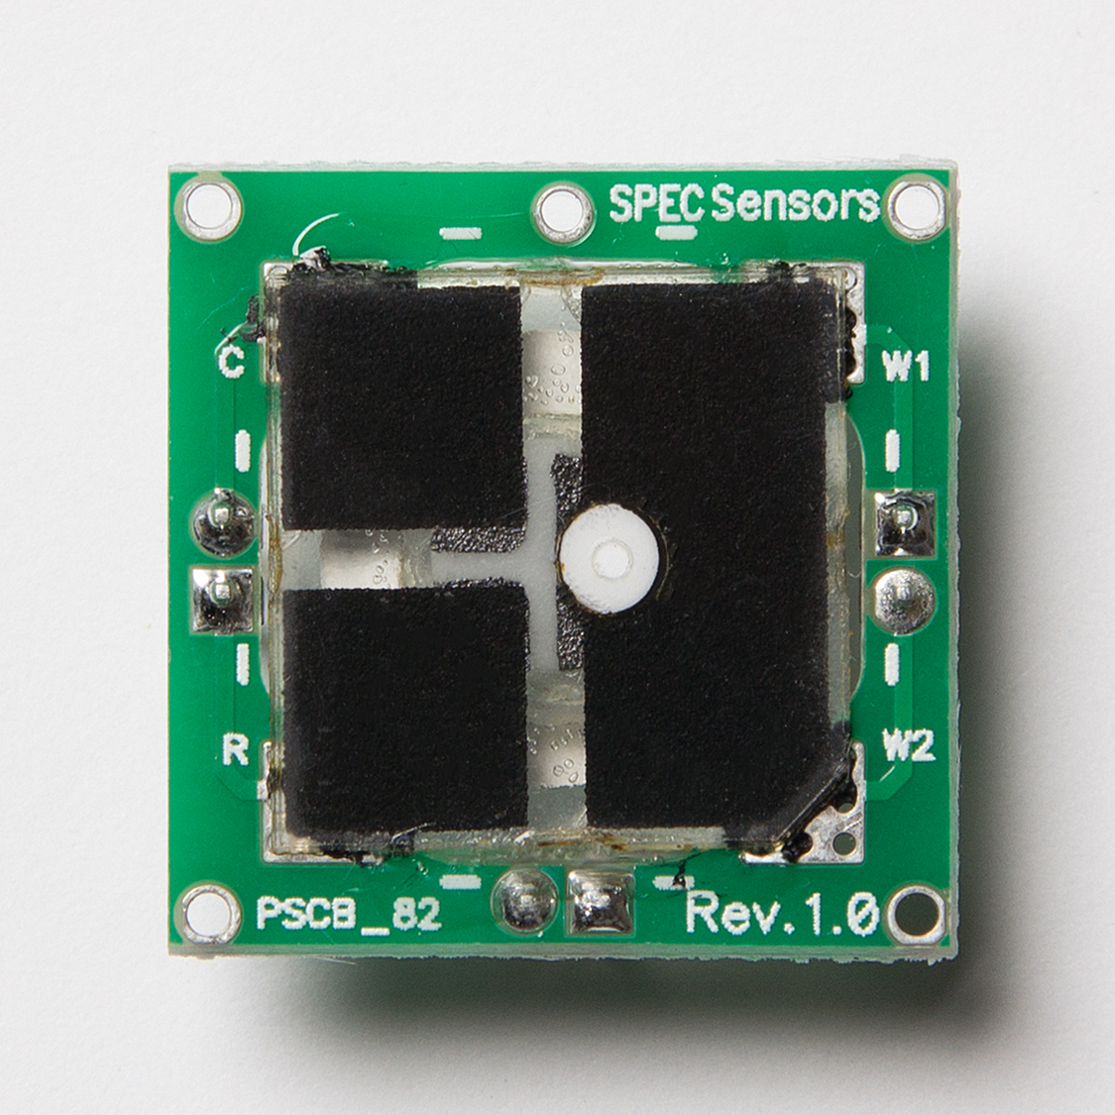
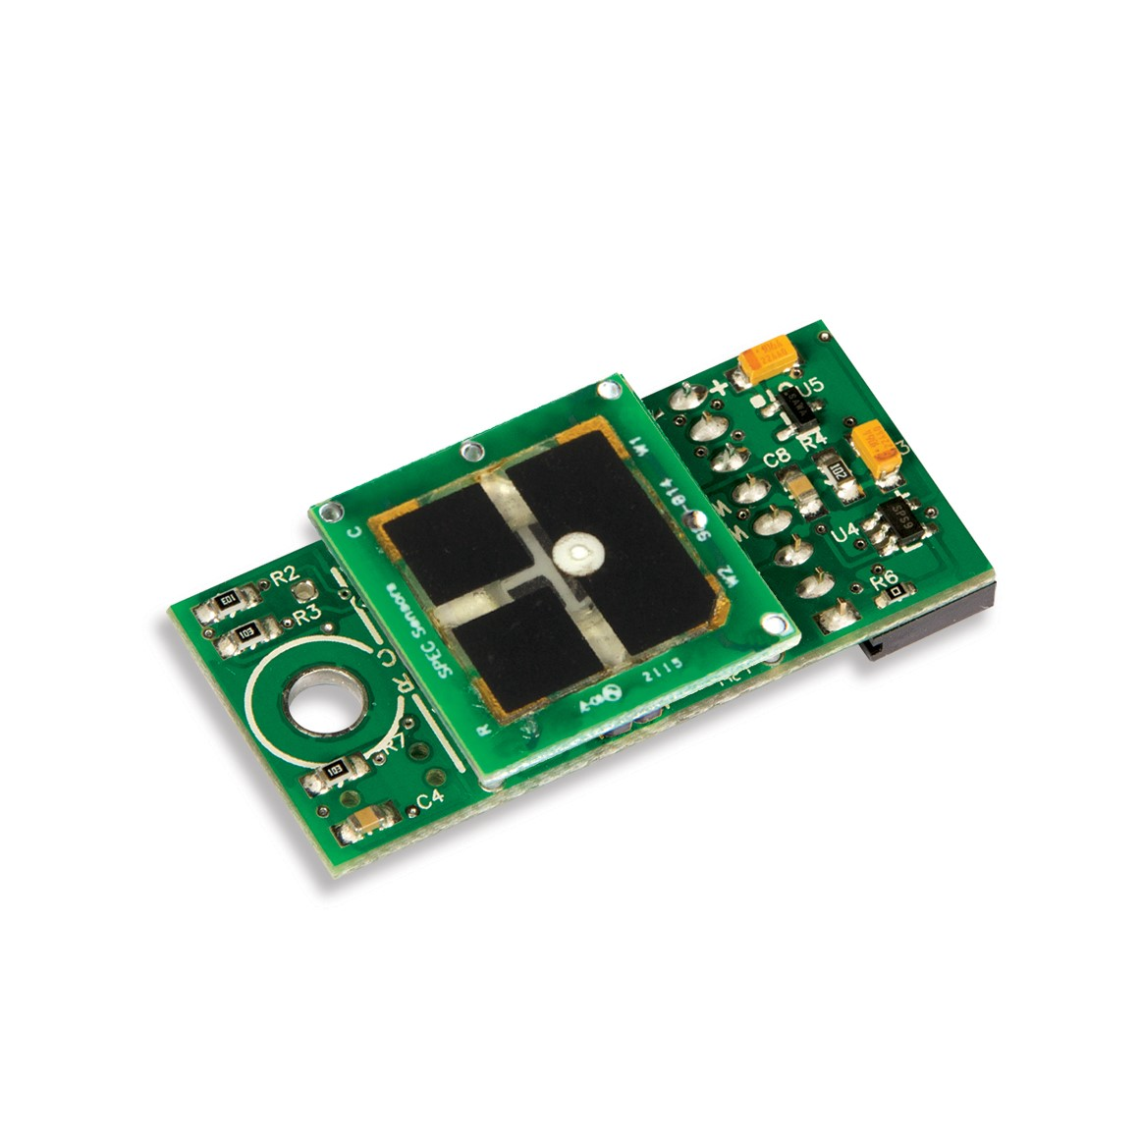
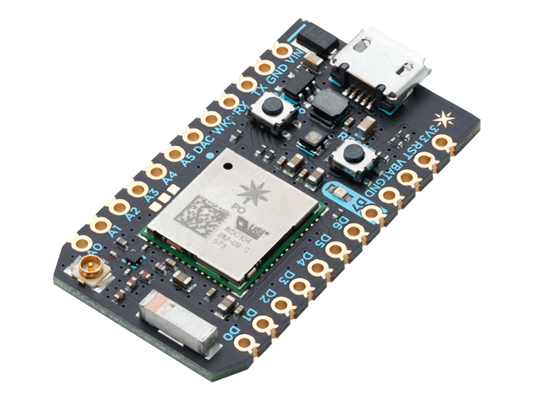
Hardware
SPEC NO2 Sensor
SPEC digital interface board
(compensates for temp/humidity)
UART interface
Particle Photon

Slide 5
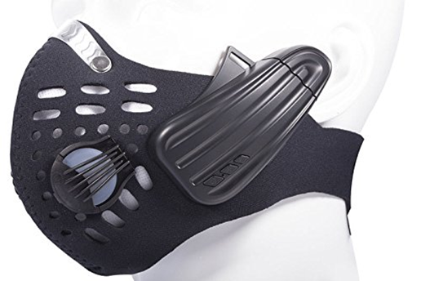
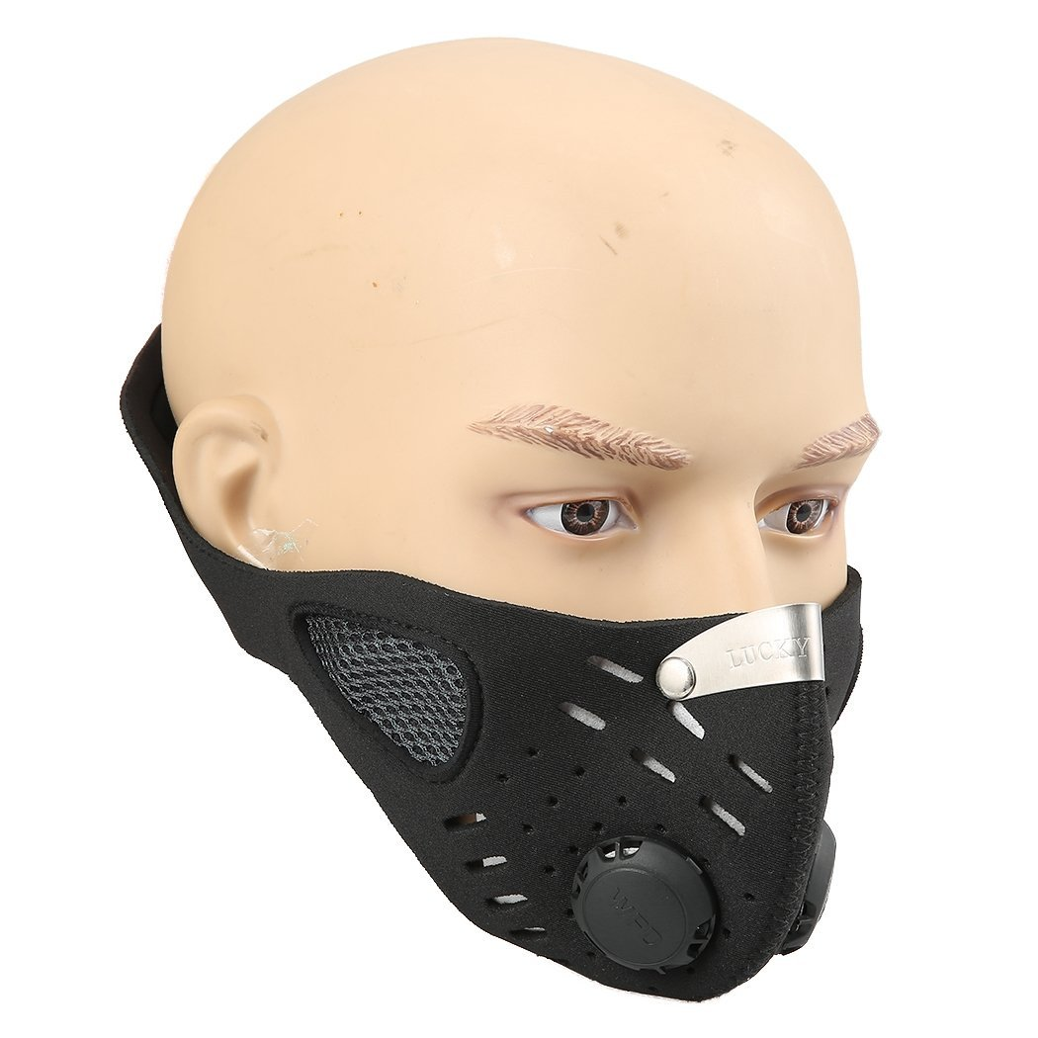
User Experience
Boblov 2-In-1 Wireless Cycling Anti-Pollution Mask
& Bone Conduction BT Bluetooth Stereo Headphone
Leeko Anti-dust Anti-pollution Mask

Slide 6
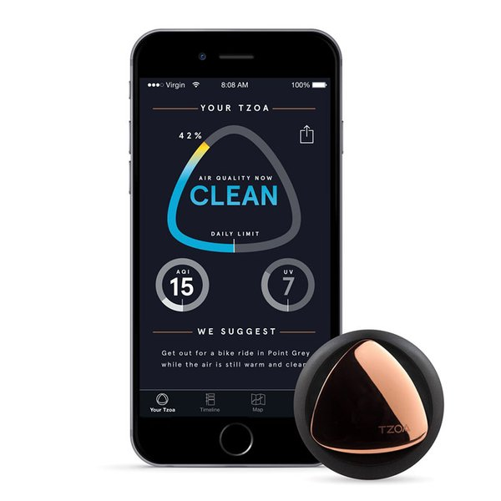
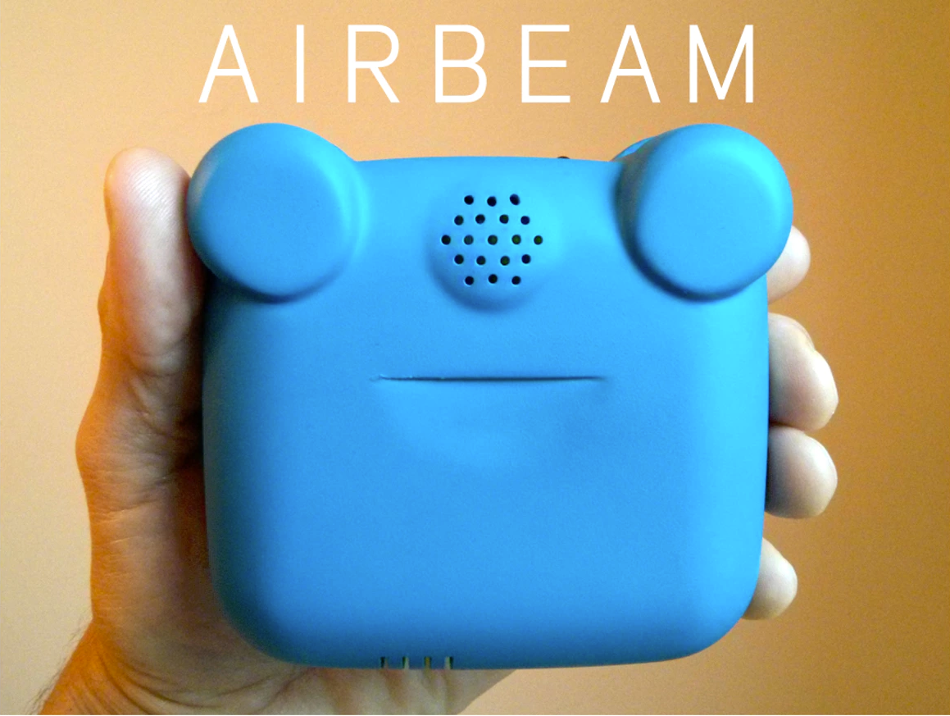
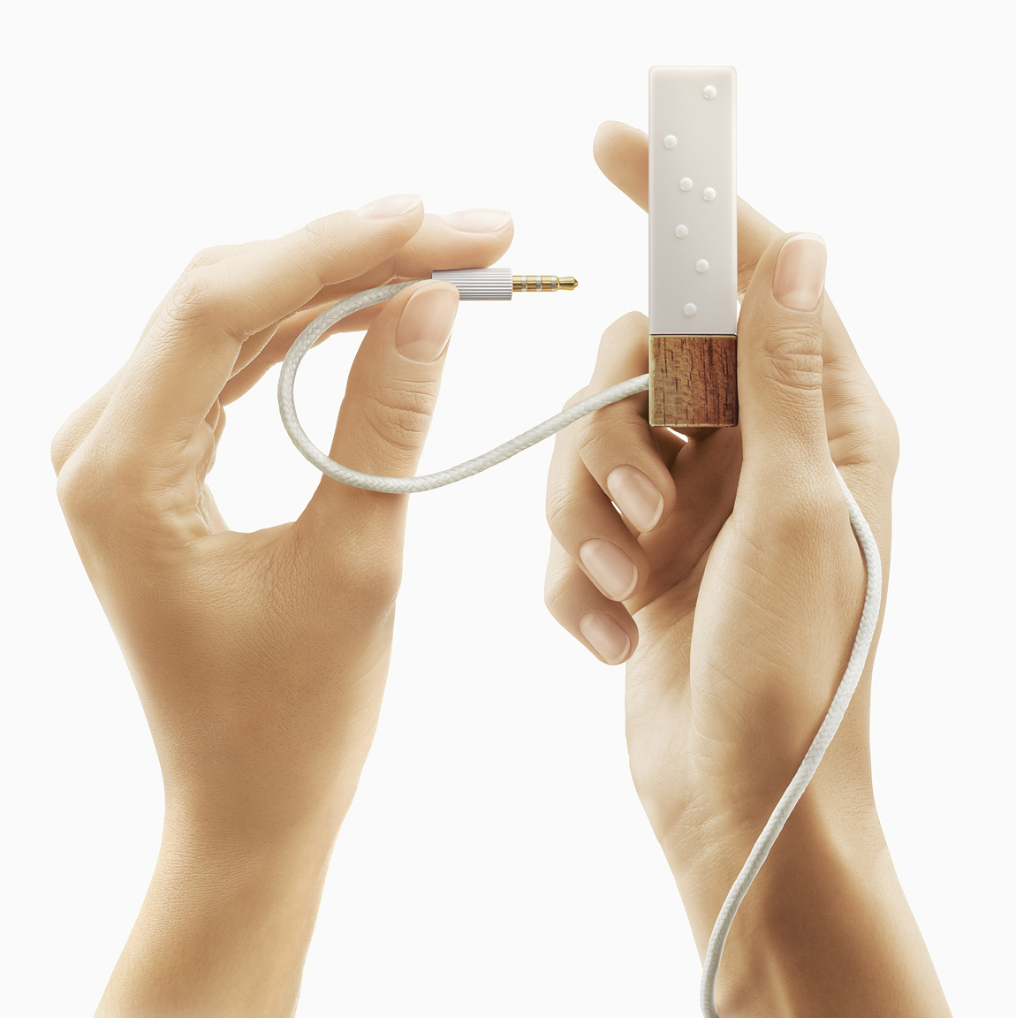
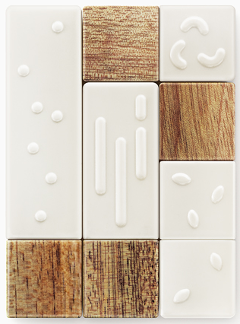
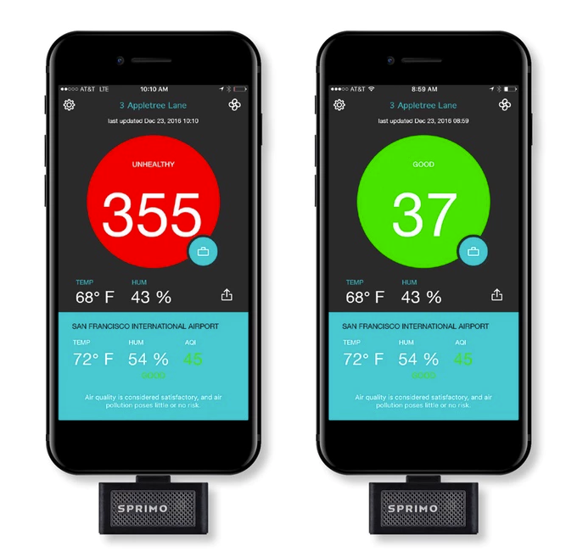
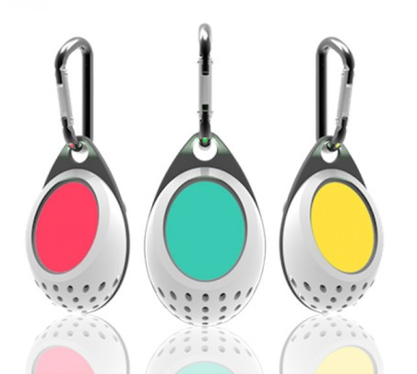
Existing and upcoming Devices “in the Wild”
TZOA
Air Quality, Temp, Humidity, light, UV
Lapka (Personal Env Sensors – not pollution)
Sprimo Personal Air Monitor
Clarity air quality monitor

Slide 7
Next Steps / Challenges
The APIs and data being sent are all fairly scalable. I would expect that it would be useable with thousands of devices, but this would require changes to the back end. While I did implement a “device specific” webhook response, Particle Products are more robust and secure.
The Geolocation and air quality apis can scale up significantly, but with costs. One way to address this would be to setup a “front” service that caches requests to reduce the number of requests actually reaching the service.
There is some logic to respond to network loss, but there
Migrate from standard Particle integrations to a Product. This will provide device authentication and more control over the data.
Need to develop a standard for Air quality ratings – there are “standards” but also proprietary measures – either look at tying in with a service provider (like Breezometer) or offload Air Quality functionality into the cloud with an aggregator service with a single interface integration from Particle.
Implement new Data back end to collect, aggregate and provide analytics on data. Provide user portal to view data from personal masks.
Explore Bluetooth model with companion smart phone application. This has some trade-offs over a pure mask only solution (but it could provide additional functionality while reducing the size/power/cost of the mask)
To be marketed as a mask, need to have IP and designs for masks, or access to an OEM for masks, or partner with a branded manufacturer. (or construct an add-on for certain types of masks)

Slide 8
Challenges
Hardware
Effectiveness and durability of available sensors unknown
Cross-sensitivity can distort results (can be compensated for with multiple sensors – but increases size, power, cost)
Cost – effective sensors can be expensive – cost needs to be driven down
Legal/Regulatory
Intellectual Property – Either need to partner with Mask / air filtration company or develop IP safe solution
Public Safety – regulations – Can a user rely on device? Is there liability?
Data
Indoor vs Outdoor quality (if you are indoors, the air quality may vary dramatically from outdoors, either better or worse.)
Market Acceptance
Find the correct price point
Target market may be international – (Urban China? Combination of high pollution with increasingly wealthy style conscious consumers)
Competitive products

Slide 9
Links
Particle https://www.particle.io/
https://breezometer.com/
https://thingspeak.com/
https://developers.google.com/maps/web-services/

Slide 10
References
Amazon.com (Search for these items)
RZ Dust/Pollution Mask w/2 Laboratory Tested Filters, Model M1, Black, Size Regular/Large
Leeko Anti-dust Anti-pollution Mask,Half Face Ski Snowboard Bike Motorcycle Cycling Mask - Free Size
Boblov 2-In-1 Wireless Cycling Anti-Pollution Mask&Bone Conduction BT Bluetooth Stereo Headphone
3M Aura Particulate Respirator 9211+/37193(AAD) N95, Stapled Flat Fold Disposable, Exhalation Valve
Vogmask Chakra N99 CV (Medium 51-130 lbs/23-58 kg)
Common Pollutants: https://www.epa.gov/air-trends
Spec Sensors: https://www.spec-sensors.com

